Slide 1



MODULE 13 – Case Study

Slide 2
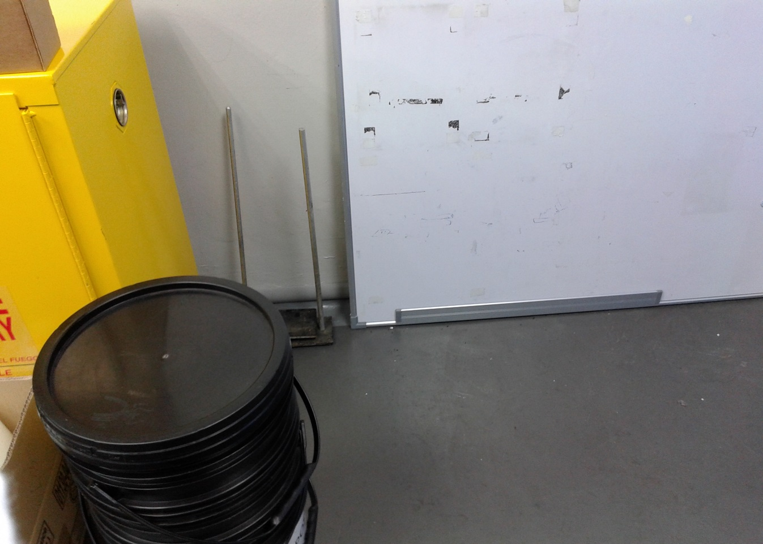
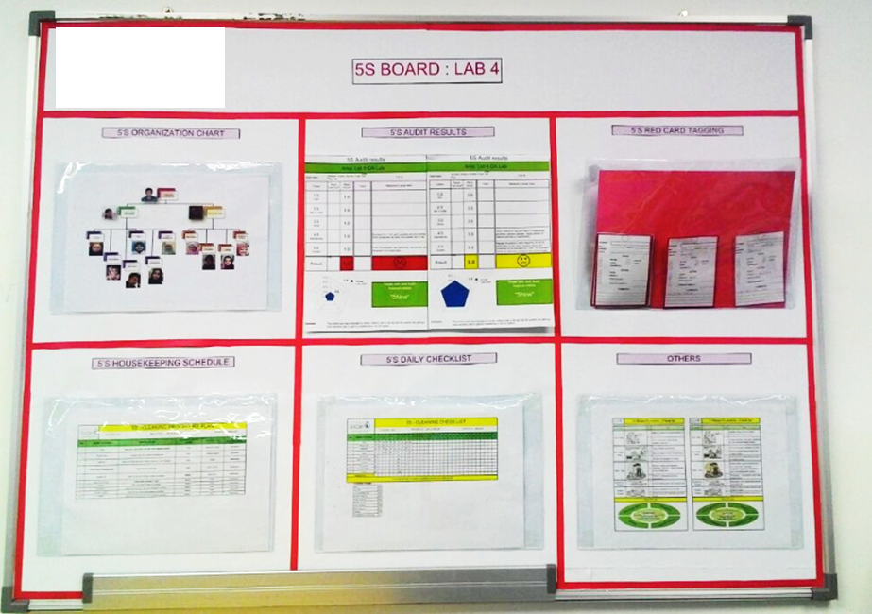
Tools Used |  | Goals ( to improve ) |  | Time |  | Waiting |  | Defect
 | Lean |  |  | Inventory |  | Over process |  | Human/ Resources
 | Six Sigma |  |  | Motion |  | Over produce |  | 5S
Description before:
Unused white board
Description after :
Transform into 5s board
Paste picture here
Paste picture here

Slide 3
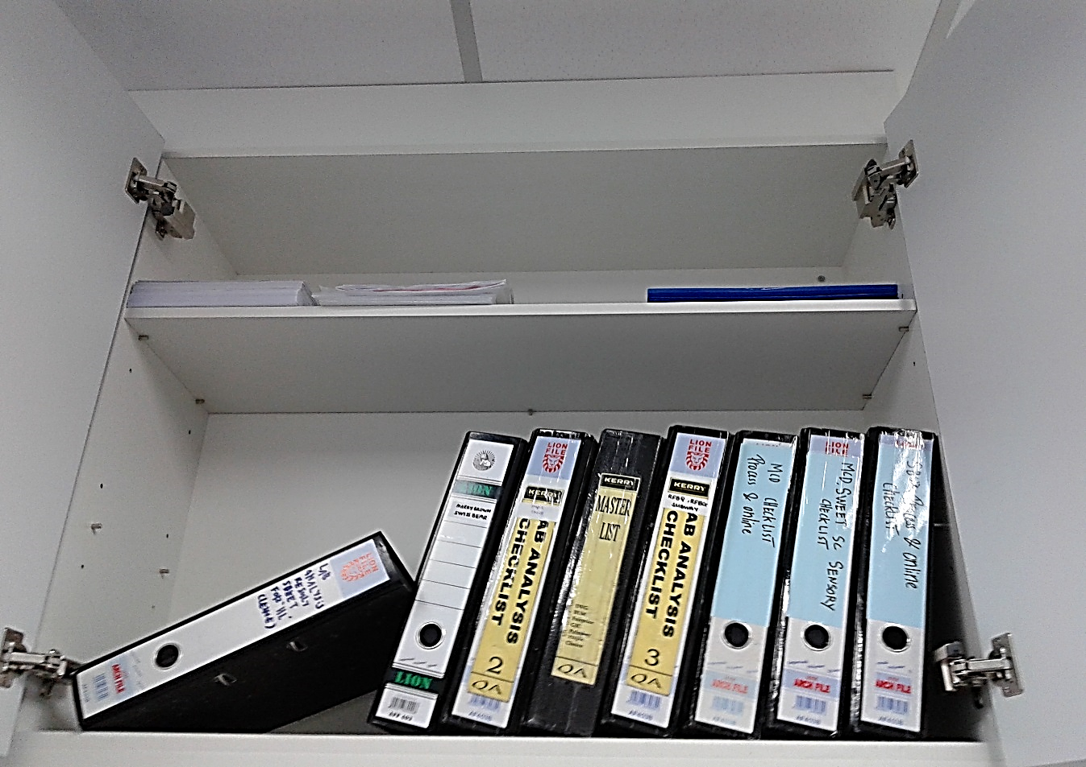
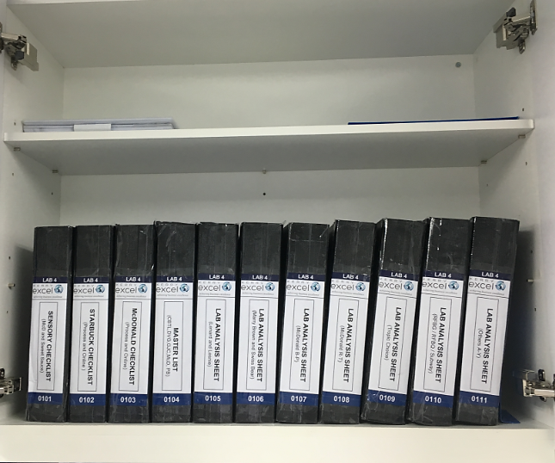
Tools Used |  | Goals ( to improve ) |  | Time |  | Waiting |  | Defect
 | Lean |  |  | Inventory |  | Over process |  | Human/ Resources
 | Six Sigma |  |  | Motion |  | Over produce |  | 5S
Description before:
Filing w/o designated format
Description after :
Filing with designated format
Paste picture here
Paste picture here

Slide 4
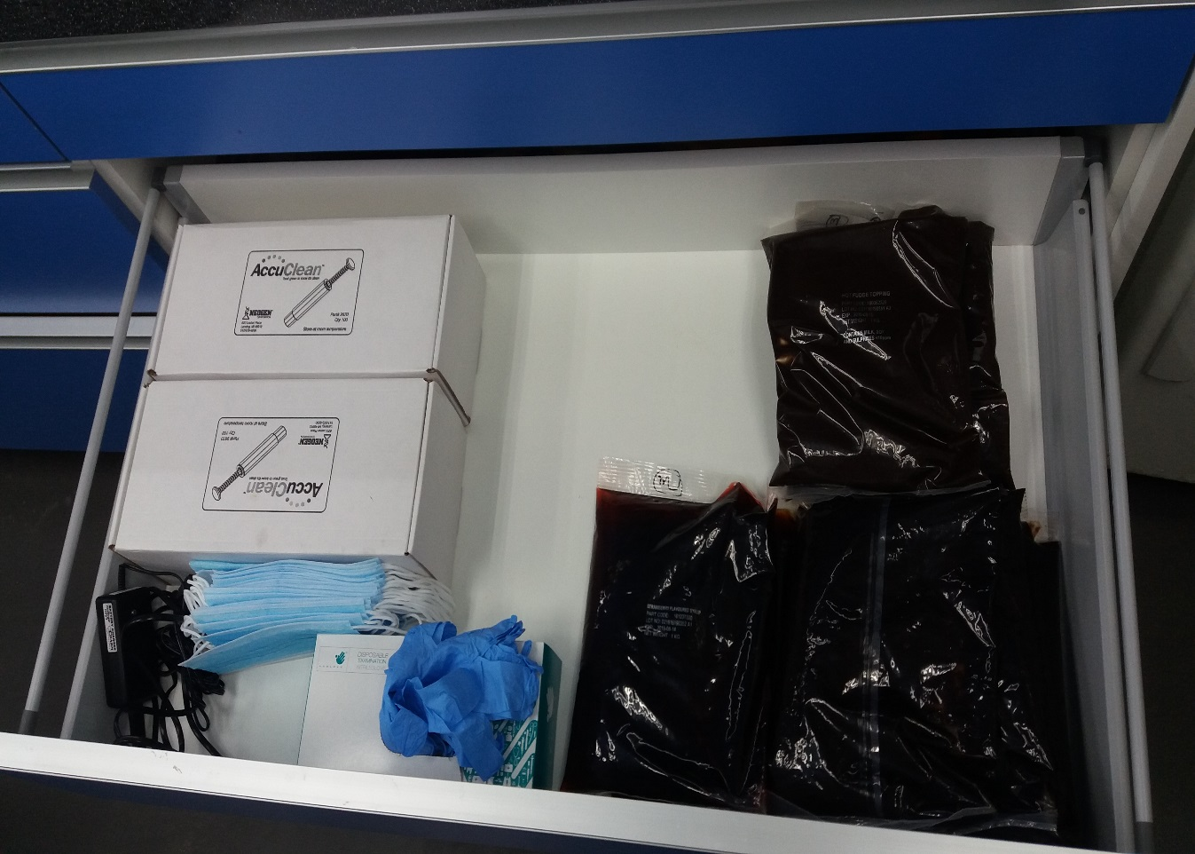
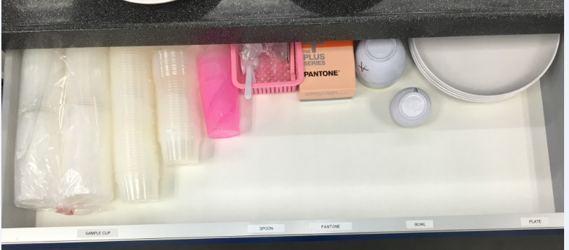
Tools Used |  | Goals ( to improve ) |  | Time |  | Waiting |  | Defect
 | Lean |  |  | Inventory |  | Over process |  | Human/ Resources
 | Six Sigma |  |  | Motion |  | Over produce |  | 5S
Description before:
All mixed up in 1 drawer,
Description after :
Each drawer is designated with individual itenary
Paste picture here
Paste picture here

Slide 5
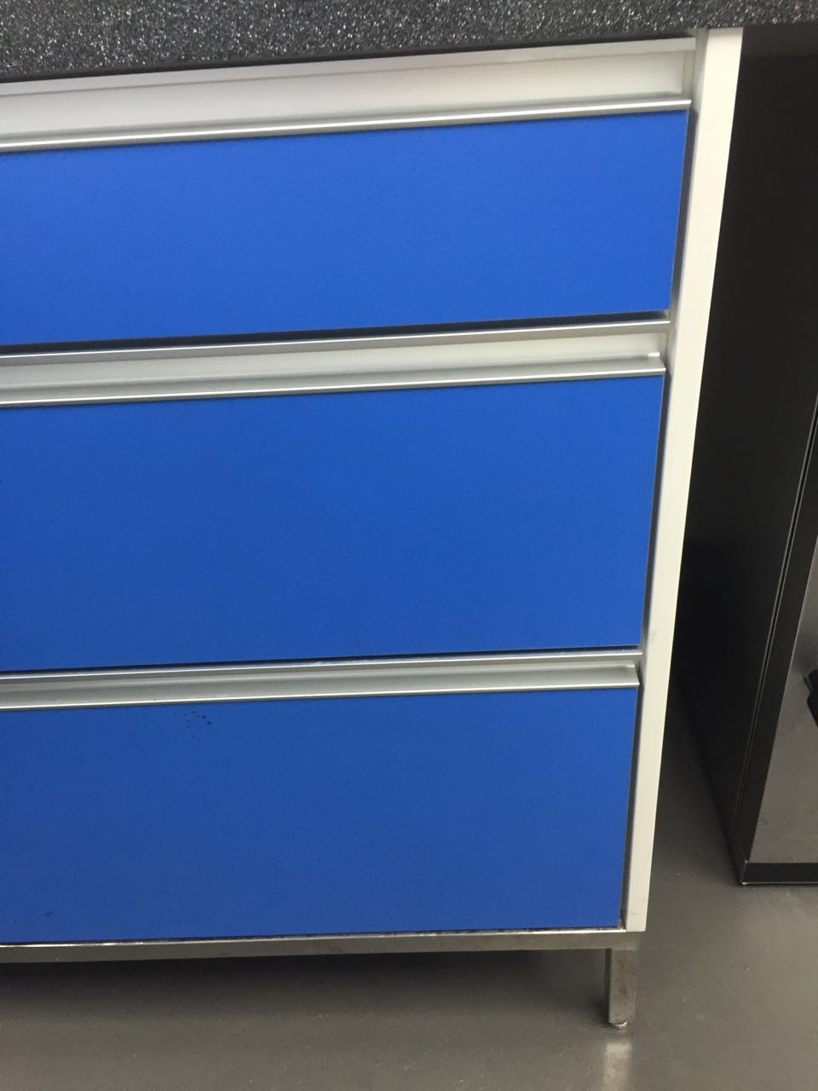
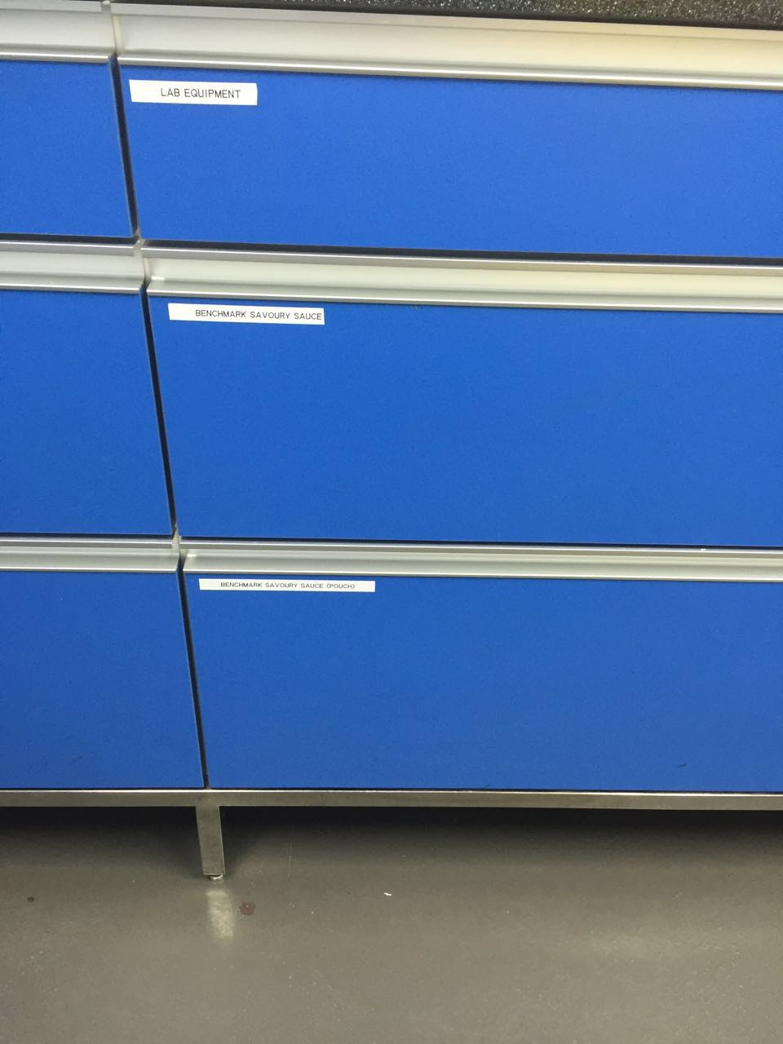
Tools Used |  | Goals ( to improve ) |  | Time |  | Waiting |  | Defect
 | Lean |  |  | Inventory |  | Over process |  | Human/ Resources
 | Six Sigma |  |  | Motion |  | Over produce |  | 5S
Description before:
Withdrawal w/o designated label
Description after :
Withdrawal with designated label
Paste picture here
Paste picture here

Slide 6


Slide 7


